Slide 1
Theoretical review of exotic states
Alessandro Pilloni
FPCP, May 24th, 2022

Slide 2
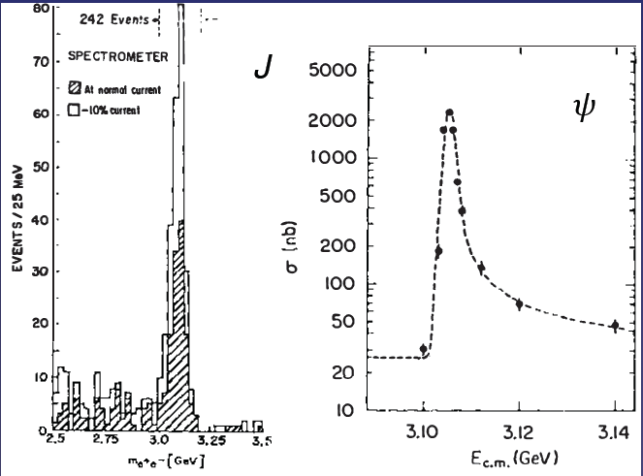
Quarkonium orthodoxy
$$Q$$
$$\overline{Q}$$
Potential models
(meaningful when $M_{Q}→∞$)
$$V\left(r\right)=−\frac{C_{F}α_{s}}{r}+σr$$
(Cornell potential)
$$α_{s}\left(M_{Q}\right)∼0.3$$
(perturbative regime)
OZI-rule, QCD multipole
Solve NR Schrödinger eq. → spectrum
Effective theories
(HQET, NRQCD, pNRQCD...)
Heavy quark spin flip suppressed by quark mass, approximate heavy quark spin symmetry (HQSS)
Integrate out heavy DOF
↓
(spectrum), decay & production rates
A. Pilloni – Theoretical review of exotic states
Notes:
2 slides su Zc, a Bes e a Belle
2 slide su tetraquark model: dall’hamiltoniana di Jaffe al calcolo delle masse
1 slide su molecular models, dove sono i carichi? (non in Tornqvist, si in Hanhart, vedere Braaten, citare Nefediev)
2 slides su decay channels, dove si dovrebbe vedere, e a seconda del modello, vedere qualche plot
1 slide su Y(4260), tetraquark? C’è lo strano (si vede la f0)
1 slide su Zc a cleo (anche il neutro)

Slide 3
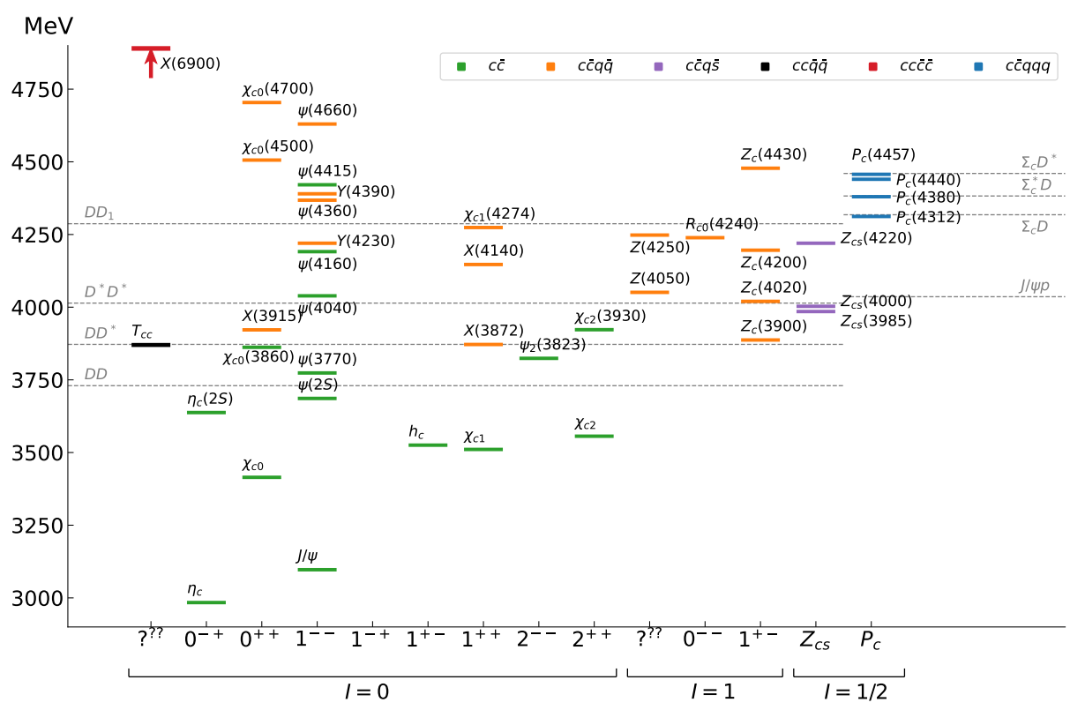
Exotic landscape at $c\overline{c}$
Esposito, AP, Polosa, Phys.Rept. 668
JPAC, arXiv:2112.13436
A host of unexpected resonances have appeared
decaying mostly into charmonium + light Hardly reconciled with usual $q\overline{q}$ pheno
A. Pilloni – Theoretical review of exotic states
Notes:
2 slides su Zc, a Bes e a Belle
2 slide su tetraquark model: dall’hamiltoniana di Jaffe al calcolo delle masse
1 slide su molecular models, dove sono i carichi? (non in Tornqvist, si in Hanhart, vedere Braaten, citare Nefediev)
2 slides su decay channels, dove si dovrebbe vedere, e a seconda del modello, vedere qualche plot
1 slide su Y(4260), tetraquark? C’è lo strano (si vede la f0)
1 slide su Zc a cleo (anche il neutro)

Slide 4
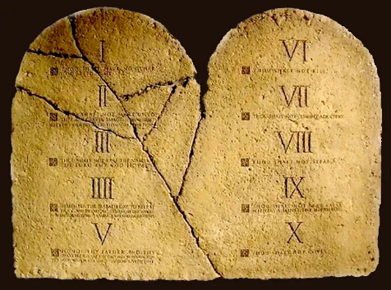
The flowchart(s)
You are given a model/theory
$$f(s)$$
You calculate the amplitude
You compare with data. Or you don’t.
Predictive power ✓
Physical interpretation ✓ (within the model! ✗) Biased by the input ✗
A. Pilloni – Theoretical review of exotic states

Slide 5
Models
Meson/Baryon+continuum
Ferretti et al., PRC88, 015207
Ferretti et al., PRD90, 094022
Ferretti et al., 1806.02489
Diquark-Antidiquark
Maiani, et al. PRD71, 014028
Faccini, AP, et al. PRD87, 111102
Maiani, et al. PRD89, 114010
Maiani, et al., PLB778, 247
Hybrids/BO tetraquarks
Kou and Pene, PLB631, 164
Braaten, PRL111, 162003
Berwein et al., PRD92, 114019
Kinematical effects
Szczepaniak, PLB747, 410
Szczepaniak, PLB757, 61
Guo et al., PRD92, 071502
Swanson, IJMPE25, 1642010
Molecule
Tornqvist, Z.Phys. C61, 525
Braaten and Kusunoki, PRD69 074005
Swanson, Phys.Rept. 429 243-305
+ Lattice
+ Sum rules + Functional methods
Hadroquarkonium
Dubynskiy et al., PLB 666, 344
Dubynskiy and Voloshin, PLB 671, 82
Li and Voloshin, MPLA29, 1450060
$$π$$
$$π$$
$$J/ψ$$
$$π$$
A. Pilloni – Theoretical review of exotic states

Slide 6
Options on the market
Quark-level calculations:
Quark models, pNRQCD, Hybrids, ...
Spectrum generally calculated as bound states of some potential
Decay rates as «overlap integrals» between two static configurations
Comprehensive picture ✓ Little scattering dynamics ✗
Hadron level calculations:
Compact states vs. molecules, triangles...
States as poles of scattering amplitudes
Couplings as residues at the poles
Scattering dynamics ✓ More case-by-case ✓✗
A. Pilloni – Theoretical review of exotic states

Slide 7
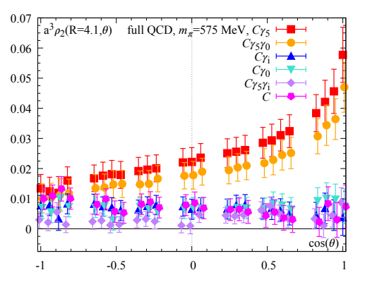
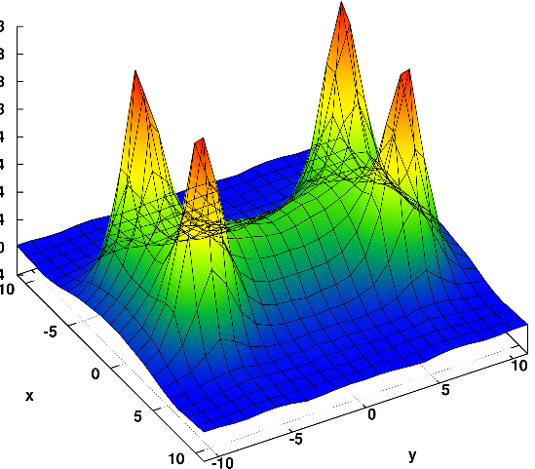
Diquarks
Attraction and repulsion in 1-gluon exchange approximation is given by
$$R=\frac{1}{2}\left(C_{2}\left(R_{12}\right)−C_{2}\left(R_{1}\right)−C_{2}\left(R_{2}\right)\right)$$
$$R_{1}=−\frac{4}{3}, R_{8}=+\frac{1}{6}$$
$$R_{3}=−\frac{2}{3}, R_{6}=+\frac{1}{3}$$
$$j$$
$$l$$
$$3_{c}×3_{c}∈{\overline{3}}_{c}$$
$$T_{ij}^{a}$$
$$T_{kl}^{a}$$
$$i$$
$$k$$
Francis et al. 2106.09080
H-shape with a 4 quark system
Cardoso, Cardoso, Bicudo, PRD84, 054508
A. Pilloni – Theoretical review of exotic states

Slide 8
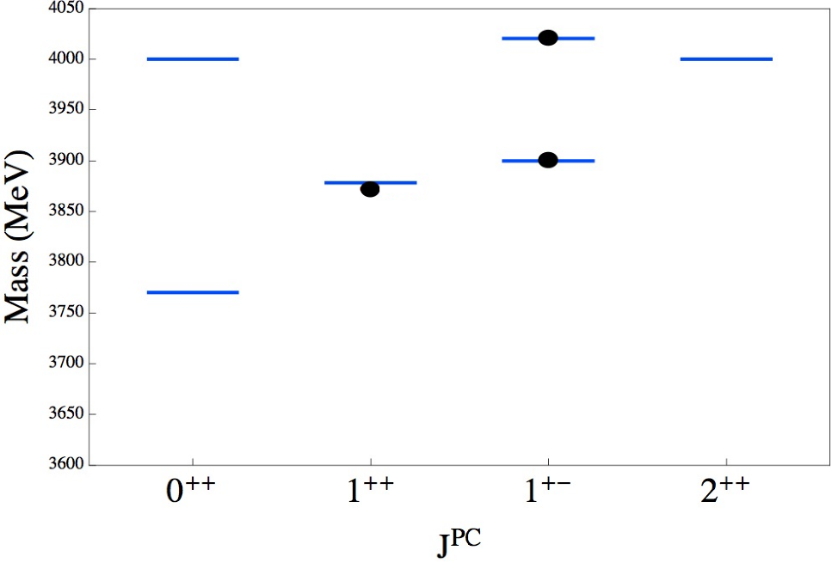
Tetraquark
$${\overline{3}}_{c}$$
$$\overline{c}$$
$$c$$
In a constituent quark model, we can think of a
diquark-antidiquark compact state
$$3_{c}$$
$$q$$
$${\left[cq\right]}_{S=0,1}{\left[\overline{c}\overline{q}′\right]}_{S=0,1}$$
$$\overline{q}$$
Maiani, Piccinini, Polosa, Riquer PRD71 014028
same + Faccini, AP, PRD87 111102
Spectrum according to color-spin hamiltonian:
$$H=\sum_{dq}{m_{dq}}+2\sum_{i<j}{κ_{ij} \vec{S_{i}}∙\vec{S_{j}} \frac{λ_{i}^{a}}{2}\frac{λ_{j}^{a}}{2}}$$
Decay pattern mostly driven by HQSS ✓
Fair understanding of existing spectrum ✓
A full nonet for each level is expected ✗
A. Pilloni – Theoretical review of exotic states
Notes:
Y(4260), M=4263 +- 5, Gamma = 95+-14
D_1(2420)^0, M=2421.3 ±0.6, Gamma =27.1 ±2.7
D_1(2420)^+-, M=2423.4 ±3.1, Gamma =25 ±6
I D_1 hanno J^P = 1^+
La molecola D_1 D sta 22 MeV sotto
Se la Y è D_1 D, il pione lega fortemente, come fa la Y a essere così larga?
Come funziona lo scambio del pione???
Close propone che la Y è D_1 D^* col pione scambiato in onda S,
La Y però non va in Ds come se fosse tetraquark

Slide 9
Other models: Molecule
Tornqvist, Z.Phys. C61, 525
Braaten and Kusunoki, PRD69 074005
Swanson, Phys.Rept. 429 243-305
$$D^{0}$$
$$X\left(3872\right)∼{\overline{D}}^{0}D^{∗0}$$
$$Z_{c}\left(3900\right)∼{\overline{D}}^{0}D^{∗+}$$
$$Z_{c}^{′}\left(4020\right)∼{\overline{D}}^{∗0}D^{∗+}$$
$$Y\left(4260\right)∼\overline{D}D_{1}$$
$$π^{0}$$
$$\overline{D^{0∗}}$$
A deuteron-like meson pair, the interaction is mediated by the exchange of light mesons
Some model-independent relations (Weinberg’s criterion) ✓
Good description of decay patterns (mostly to constituents) and $X\left(3872\right)$ isospin violation ✓
States appear close to thresholds ✓
Unclear spectrum (a state for each threshold?) – depends on potential models ✗
$$V_{π}\left(r\right)=\frac{g_{πN}^{2}}{3}\left(\vec{τ_{1}}⋅\vec{τ_{2}}\right)\left\{\left[3\left(\vec{σ_{1}}⋅\hat{r}\right)\left(\vec{σ_{2}}⋅\hat{r}\right)−\left(\vec{σ_{1}}⋅\vec{σ_{2}}\right)\right]\left(1+\frac{3}{{\left(m_{π}r\right)}^{2}}+\frac{3}{m_{π}r}\right)+\left(\vec{σ_{1}}⋅\vec{σ_{2}}\right)\right\}\frac{e^{−m_{π}r}}{r}$$
Needs regularization, cutoff dependence
A. Pilloni – Theoretical review of exotic states

Slide 10
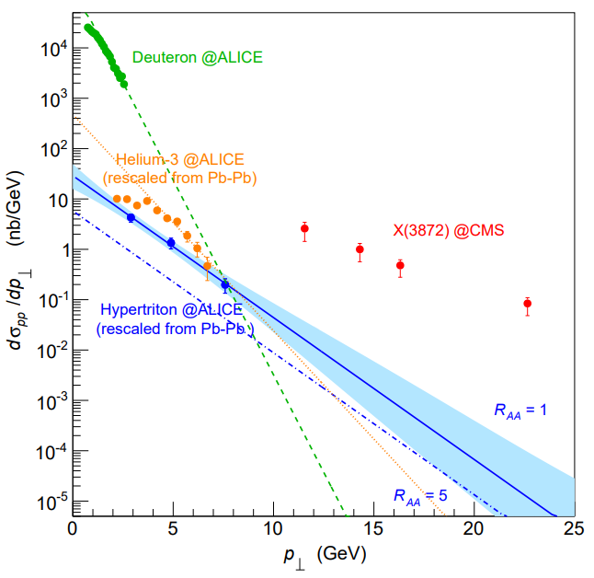
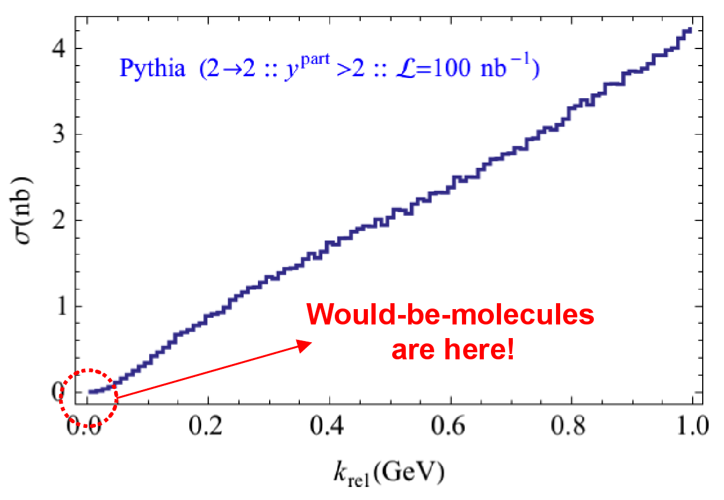
Prompt production of $X(3872)$
However, the applicability of Watson theorem is challenged by the presence of pions that interfere with $DD^{∗}$ propagation
$$D^{∗}$$
$$π$$
$$π$$
(CDF acceptance)
$$π$$
$$π$$
$$π$$
$$\overline{D^{0}}$$
A solution can be FSI (rescattering of $DD^{∗}$), which allow $k_{max}$ to be as large as $5m_{π}$, $σ\left(p\overline{p}→DD^{∗}|k<k_{max}\right)≈230 \text{nb}$
Artoisenet and Braaten, PRD81, 114018
However, this is controversial because of the presence of comover that interfere with $DD^{∗}$ propagation
Bignamini et al. PLB684, 228-230
Esposito, Piccinini, AP, Polosa, JMP 4, 1569
Guerrieri, Piccinini, AP, Polosa, PRD90, 034003
$$σ_{MC}\left(p\overline{p}→DD^{∗}|k<k_{max}\right)≈0.1 \text{nb}$$
$σ_{exp}\left(p\overline{p}→X(3872)\right)≈30−70 \text{nb}$!!!
The comparison of production of other light nuclei suggests a different behavior
Esposito, Guerrieri, Maiani, Piccinini, AP, Polosa, Riquer, PRD92 (2015) 3, 034028
Bignamini et al. PRL103 (2009) 162001
A. Pilloni – Theoretical review of exotic states
Notes:
2 slides su Zc, a Bes e a Belle
2 slide su tetraquark model: dall’hamiltoniana di Jaffe al calcolo delle masse
1 slide su molecular models, dove sono i carichi? (non in Tornqvist, si in Hanhart, vedere Braaten, citare Nefediev)
2 slides su decay channels, dove si dovrebbe vedere, e a seconda del modello, vedere qualche plot
1 slide su Y(4260), tetraquark? C’è lo strano (si vede la f0)
1 slide su Zc a cleo (anche il neutro)

Slide 11
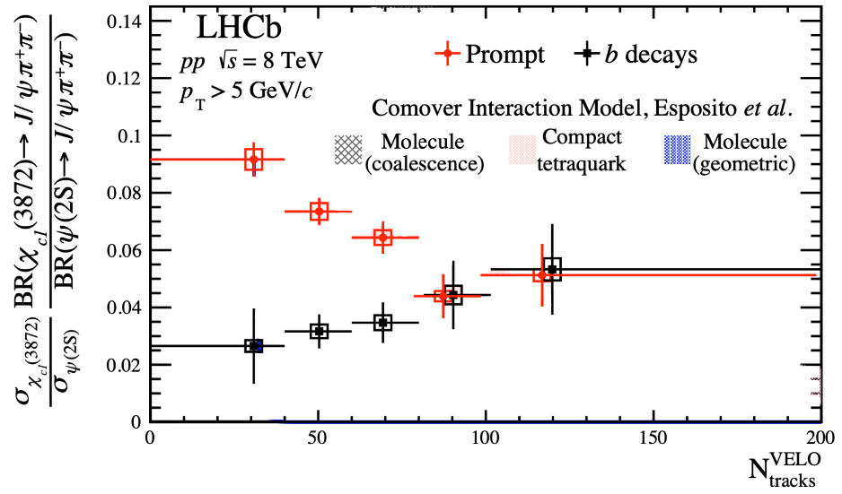
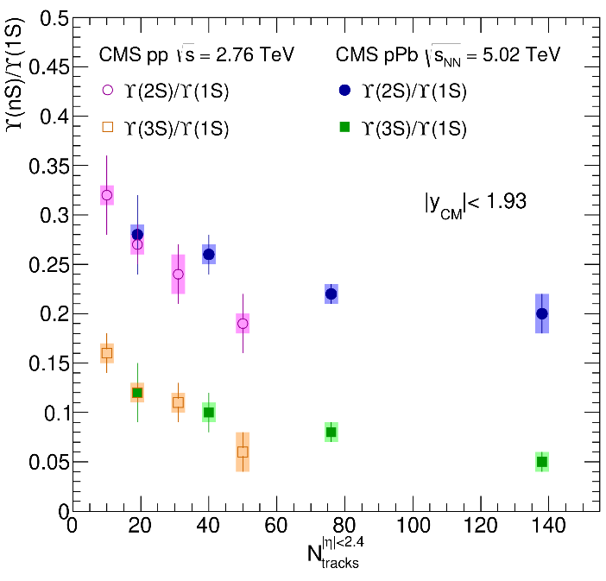
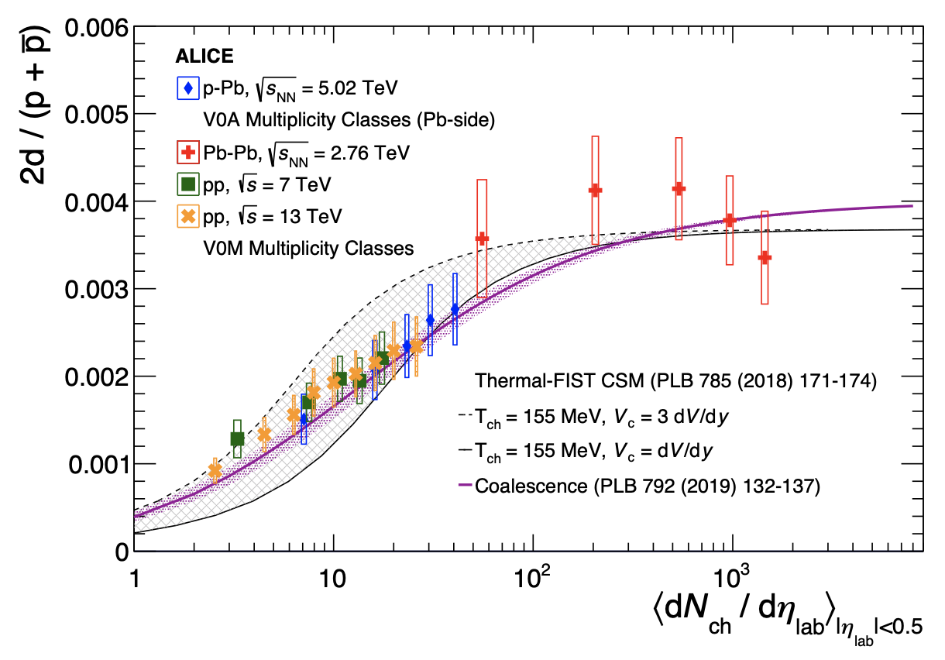
Multiplicity dependence
The $X(3872)$is more and more suppressed wrt $ψ(2S)$when more comovers are present Does it make the $X(3872)$a fragile molecule?
The $X(3872)$is more and more suppressed wrt $ψ(2S)$when more comovers are present Does it make the $X(3872)$a fragile molecule? No.
LHCb 2009.06619
Deuteron is a molecule, but it increases
CMS JHEP04(2014), 103
ALICE EPJC80, 9, 889
$Υ(2S)$ and $Υ\left(3S\right)$ are not molecules, but they decrease
$Υ(2S)$ and $Υ\left(3S\right)$ are not molecules, but they decrease
A. Pilloni – Theoretical review of exotic states
Notes:
2 slides su Zc, a Bes e a Belle
2 slide su tetraquark model: dall’hamiltoniana di Jaffe al calcolo delle masse
1 slide su molecular models, dove sono i carichi? (non in Tornqvist, si in Hanhart, vedere Braaten, citare Nefediev)
2 slides su decay channels, dove si dovrebbe vedere, e a seconda del modello, vedere qualche plot
1 slide su Y(4260), tetraquark? C’è lo strano (si vede la f0)
1 slide su Zc a cleo (anche il neutro)

Slide 12
The comover model
The interaction with final state comoving particles can help create/destroy a hadron
Baym PLB138, 18
For a compact state in 𝑝𝑝 collisions the number evolves following
hadron yield
destruction cross section
$$τ\frac{dN_{𝒬}}{dτ}=−⟨vσ⟩_{𝒬}ρ_{c}N_{𝒬}$$
comover density at initial time (Glauber model) $∝N_{ch}$
In the Comover Interaction Model one takes $⟨vσ⟩_{𝒬}∼πr_{𝒬}^{2}$
This has proved to be successful at describing 𝑝Pb and PbPb data
Ferreiro PLB749, 98
Ferreiro, Lansberg JHEP10(2018), 94
A. Pilloni – Theoretical review of exotic states
Notes:
2 slides su Zc, a Bes e a Belle
2 slide su tetraquark model: dall’hamiltoniana di Jaffe al calcolo delle masse
1 slide su molecular models, dove sono i carichi? (non in Tornqvist, si in Hanhart, vedere Braaten, citare Nefediev)
2 slides su decay channels, dove si dovrebbe vedere, e a seconda del modello, vedere qualche plot
1 slide su Y(4260), tetraquark? C’è lo strano (si vede la f0)
1 slide su Zc a cleo (anche il neutro)

Slide 13
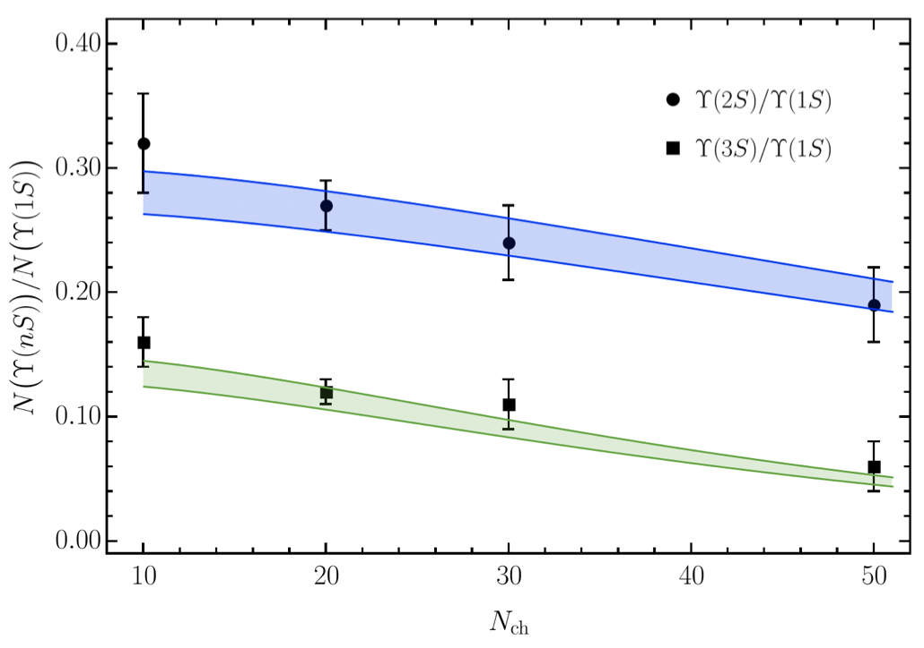
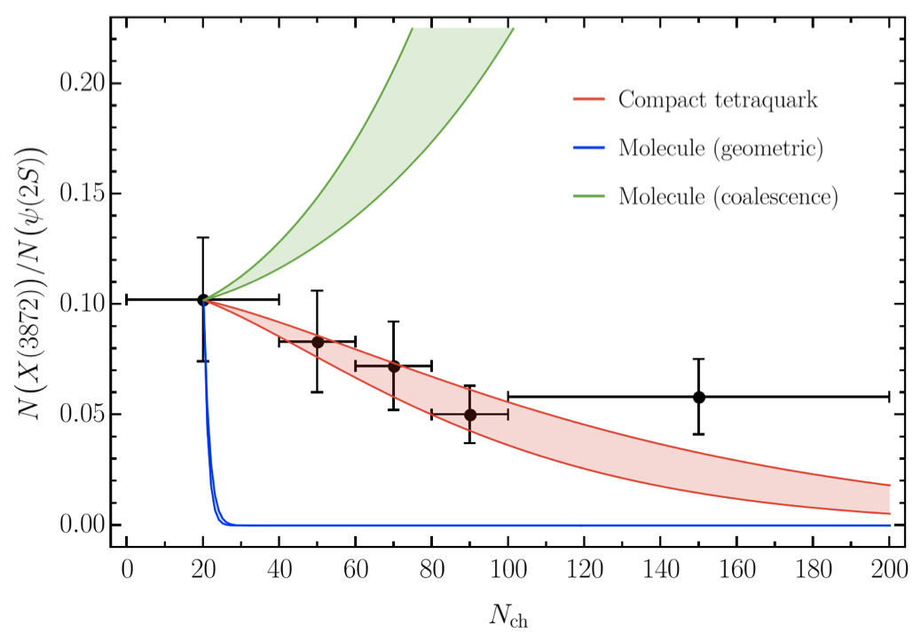
Bottomonia & $X(3872)$
Further validate the model using CMS $pp$ data Using same cross sections as in 𝑝Pb and PbPb
Same model for a compact $X(3872)$
( data)
( data)
Esposito, Ferreiro, AP, Polosa, Salgado EPJC 81 (2021) 7, 669
A. Pilloni – Theoretical review of exotic states
Notes:
2 slides su Zc, a Bes e a Belle
2 slide su tetraquark model: dall’hamiltoniana di Jaffe al calcolo delle masse
1 slide su molecular models, dove sono i carichi? (non in Tornqvist, si in Hanhart, vedere Braaten, citare Nefediev)
2 slides su decay channels, dove si dovrebbe vedere, e a seconda del modello, vedere qualche plot
1 slide su Y(4260), tetraquark? C’è lo strano (si vede la f0)
1 slide su Zc a cleo (anche il neutro)

Slide 14
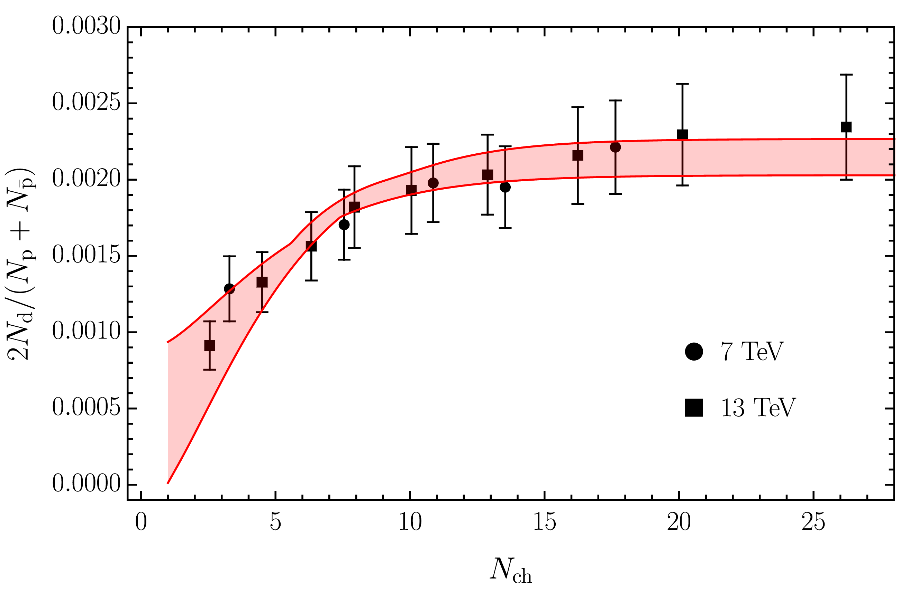
Deuteron in coalescence model
Solution of the evolution equation with recombination
$$\frac{N_{m}}{N_{h}}=\frac{{\left\langle vσ\right\rangle }_{m}}{{\left\langle vσ\right\rangle }_{m}+{\left\langle vσ\right\rangle }_{hh}}+\left(\frac{N_{m}^{0}}{N_{h}^{0}}−\frac{{\left\langle vσ\right\rangle }_{m}}{{\left\langle vσ\right\rangle }_{m}+{\left\langle vσ\right\rangle }_{hh}}\right)e^{−\left({\left\langle vσ\right\rangle }_{m}+{\left\langle vσ\right\rangle }_{hh}\right)ρ_{c}\ln\left(ρ_{c}/ρ_{c}^{pp}\right)}$$
( data)
Numbers of molecule at $t=0$,
$≈0$ in Pythia
The coalescence momentum for deuteron is known to be $Λ=50 ÷200 \text{MeV}$
Cross sections calculated from scattering of constituents
A. Pilloni – Theoretical review of exotic states
Notes:
2 slides su Zc, a Bes e a Belle
2 slide su tetraquark model: dall’hamiltoniana di Jaffe al calcolo delle masse
1 slide su molecular models, dove sono i carichi? (non in Tornqvist, si in Hanhart, vedere Braaten, citare Nefediev)
2 slides su decay channels, dove si dovrebbe vedere, e a seconda del modello, vedere qualche plot
1 slide su Y(4260), tetraquark? C’è lo strano (si vede la f0)
1 slide su Zc a cleo (anche il neutro)

Slide 15
$X(3872)$ again
( data)
The coalescence momentum for the $X(3872)$ is $Λ=30 ÷300 \text{MeV}$
Controversies for $N_{m}/N_{h}$: How is the 𝑋 produced?
Through ${\overline{D}}^{0}D^{∗0}$: $N_{m}/N_{h}≈0$
Through $χ_{c1}(2P)$: $N_{m}/N_{h}≈1$
The difference shown with a green band
A. Pilloni – Theoretical review of exotic states
Notes:
2 slides su Zc, a Bes e a Belle
2 slide su tetraquark model: dall’hamiltoniana di Jaffe al calcolo delle masse
1 slide su molecular models, dove sono i carichi? (non in Tornqvist, si in Hanhart, vedere Braaten, citare Nefediev)
2 slides su decay channels, dove si dovrebbe vedere, e a seconda del modello, vedere qualche plot
1 slide su Y(4260), tetraquark? C’è lo strano (si vede la f0)
1 slide su Zc a cleo (anche il neutro)

Slide 16
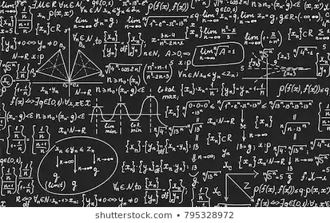
The flowchart(s)
Less predictive power ✗
Some physical interpretation ✗ Minimally biased ✓
You extract physics
You choose a set of generic amplitudes
You start with data
A. Pilloni – Theoretical review of exotic states

Slide 17
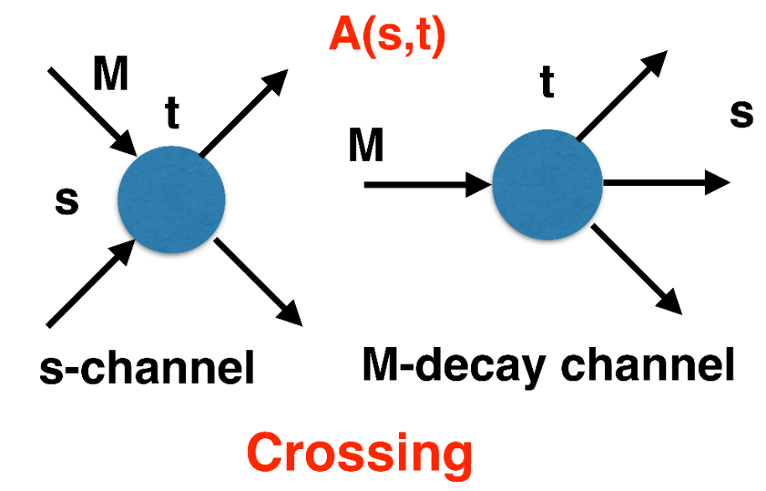
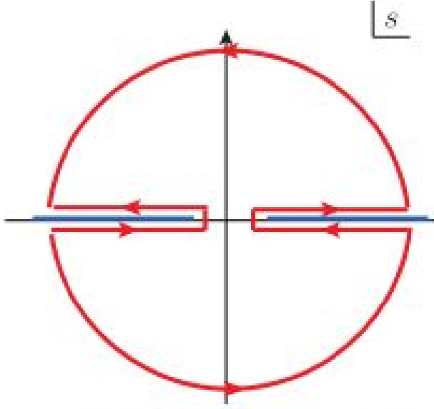
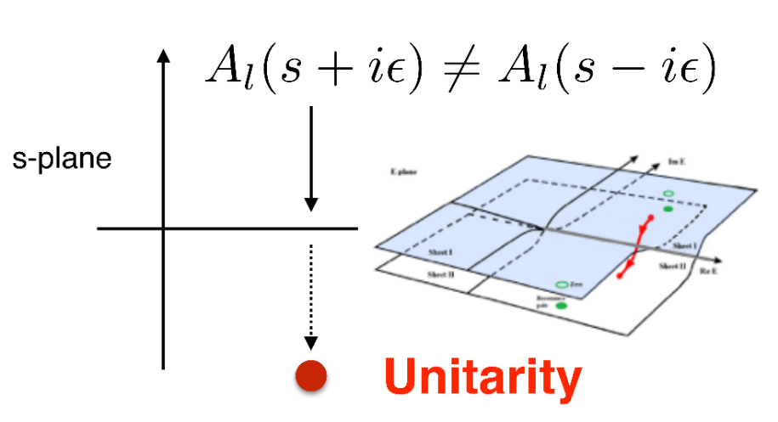
$S$-Matrix principles
$$t_{l}\left(s\right)=\lim_{ε→0}t_{l}(s+iε)⁡$$
Analyticity
$$\text{Im} t_{l}=ρ_{l}{\left|t_{l}\right|}^{2} ⁡$$
These are constraints the amplitudes have to satisfy, but do not fix the dynamics
They can be imposed with an increasing amount of rigor, to extract robust physics information
The «background» phenomena can be effectively parameterized in a controlled way
+ Lorentz, discrete & global symmetries
A. Pilloni – Theoretical review of exotic states
Notes:
Controlla la parte su Regge

Slide 18
Bound and virtual states
Decreasing the potential strength, the pole reaches threshold
The pole jumps on the 2nd sheet (dineutron), it becomes a virtual state
Example from $pn$ scattering Bound state on the real axis 1st sheet (deuteron)
$$V(r)$$
$$\text{Im} E$$
$$r$$
$$V$$
Deuteron
$$\text{Re} E$$
$${}_{}^{1}S$$
Deuteron pole
Dineutron pole
$${}_{}^{3}S$$
A. Pilloni – Theoretical review of exotic states
Notes:
Controlla la parte su Regge

Slide 19
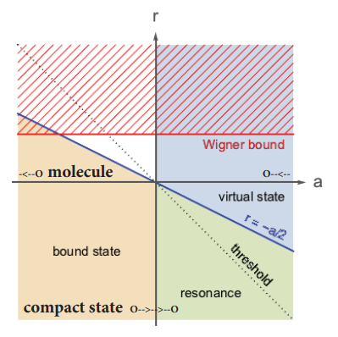
Bound and virtual states
The amplitude close to threshold can be expanded as
$$A\left(E\right)=\frac{1}{\frac{1}{a}+\frac{1}{2}r_{0}k^{2}−ik+O\left(k^{4}\right)}$$
$a$ is the scattering length
$r_{0}$is the effective range
The sign of $a$ controls whether we have a bound or virtual state
Matuschek et al. EPJA57 (2021) 3, 101
A. Pilloni – Theoretical review of exotic states
Notes:
Controlla la parte su Regge

Slide 20
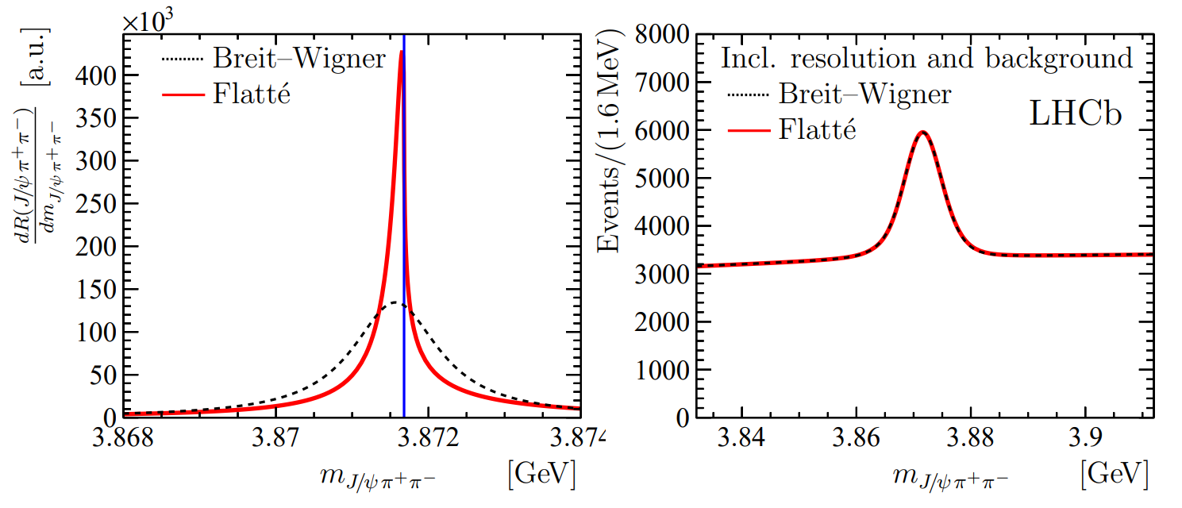
The lineshape of the $X(3872)$
LHCb, PRD 102, 092005
Blue line is $D^{0}\overline{D^{∗0}}$,
$D^{+}D^{∗−}$ is $δ=8.2 \text{MeV}$
heavier
Because of experimental resolution, different lineshapes are indistinguishable
Unitary parametrizations tend to be narrower, $Γ_{BW}=1.39±0.24±0.10 \text{MeV}$, $Γ_{Fl}={0.22}_{−0.06−0.13}^{+0.07+0.11} \text{MeV}$
A. Pilloni – Theoretical review of exotic states
Notes:
Controlla la parte su Regge

Slide 21
The lineshape of the $X(3872)$
Esposito, Maiani, AP, Polosa, Riquer, PRD 105 (2022) 3, L031503
LHCb data is fitted with the Flatte’ parametrization
The $D^{0}\overline{D^{∗0}}$ threshold
Two options: a) I set $δ=0$ b) I expand at threshold
The $D^{+}D^{∗−}$ threshold
The $J/ψ ρ,ω,$ and other unknown channels
This considers coupled channel, but Weinberg’s criterion applies to single channel bound states only
A. Pilloni – Theoretical review of exotic states
Notes:
Controlla la parte su Regge

Slide 22
The lineshape of the $X(3872)$
Esposito, Maiani, AP, Polosa, Riquer, PRD 105 (2022) 3, L031503
Option b)
Option a)
According to Weinberg’s, the first result points to a sizeable short-range structure of the X(3872)
Still disagreement on how to perform the extraction though
A. Pilloni – Theoretical review of exotic states
Notes:
Controlla la parte su Regge

Slide 23
New pentaquarks discovered
The lowest $P_{c}(4312)$ appears as an isolated peak at the $Σ_{c}^{+}{\overline{D}}^{0}$ threshold
A detailed study of the lineshape provides insight on its nature
Bottom-up: DON’T YOU DARE describing everything!!! Focus on the peak region
A. Pilloni – Theoretical review of exotic states
Notes:
Controlla la parte su Regge

Slide 24
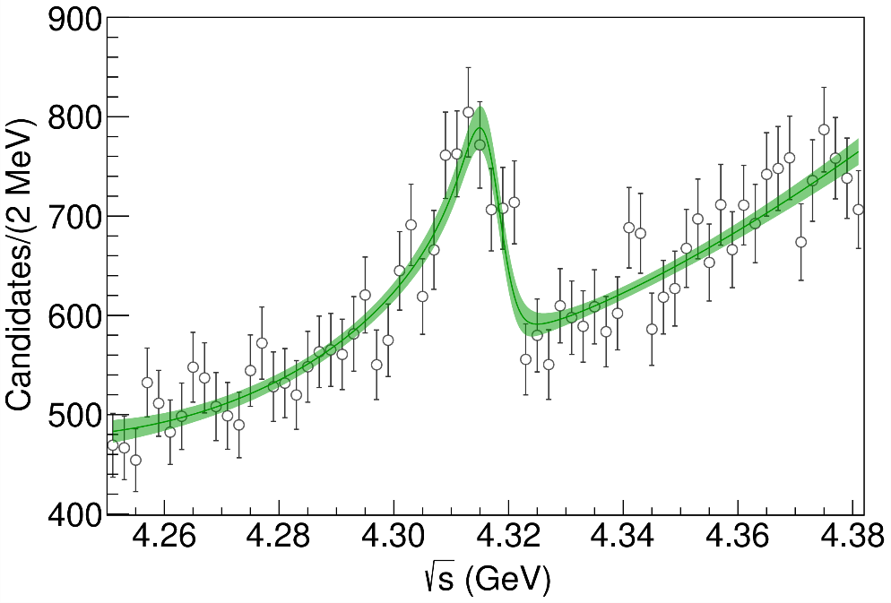
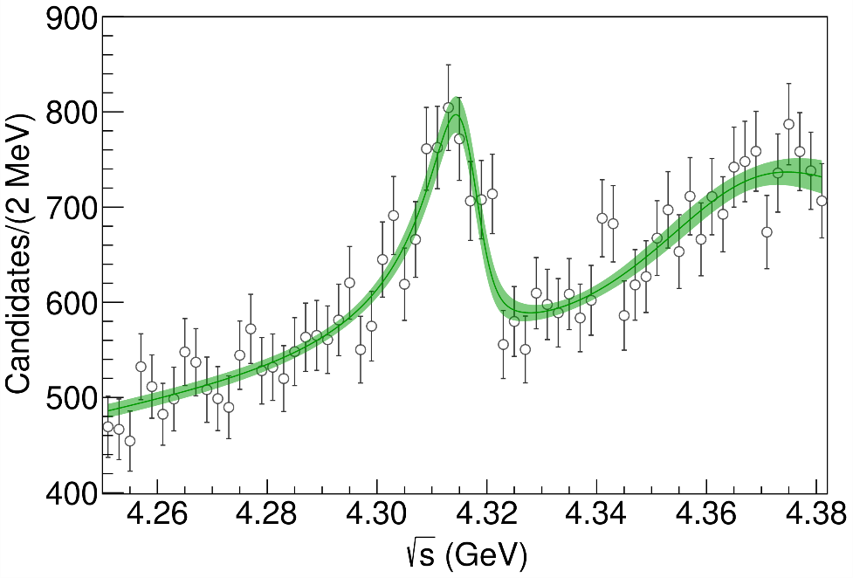
Minimal(istic) model for $P_{c}(4312)$
( data)
Fernandez-Ramirez, AP et al. (JPAC), PRL 123, 092001
Effective range expansion We can set $c_{ii}=0$ to reduce to the scattering length approximation
$$c_{ii}=0$$
Finite $c_{ii}$
A. Pilloni – Theoretical review of exotic states
Notes:
2 slides su Zc, a Bes e a Belle
2 slide su tetraquark model: dall’hamiltoniana di Jaffe al calcolo delle masse
1 slide su molecular models, dove sono i carichi? (non in Tornqvist, si in Hanhart, vedere Braaten, citare Nefediev)
2 slides su decay channels, dove si dovrebbe vedere, e a seconda del modello, vedere qualche plot
1 slide su Y(4260), tetraquark? C’è lo strano (si vede la f0)
1 slide su Zc a cleo (anche il neutro)

Slide 25
Minimal(istic) model for $P_{c}(4312)$
Effective range expansion We can set $c_{ii}=0$ to reduce to the scattering length approximation
$$c_{ii}=0$$
Finite $c_{ii}$
A. Pilloni – Theoretical review of exotic states
Notes:
2 slides su Zc, a Bes e a Belle
2 slide su tetraquark model: dall’hamiltoniana di Jaffe al calcolo delle masse
1 slide su molecular models, dove sono i carichi? (non in Tornqvist, si in Hanhart, vedere Braaten, citare Nefediev)
2 slides su decay channels, dove si dovrebbe vedere, e a seconda del modello, vedere qualche plot
1 slide su Y(4260), tetraquark? C’è lo strano (si vede la f0)
1 slide su Zc a cleo (anche il neutro)

Slide 26
Minimal(istic) model for $P_{c}(4312)$
Effective range expansion We can set $c_{ii}=0$ to reduce to the scattering length approximation
Points to a virtual state
$$c_{ii}=0$$
Finite $c_{ii}$
A. Pilloni – Theoretical review of exotic states
Notes:
2 slides su Zc, a Bes e a Belle
2 slide su tetraquark model: dall’hamiltoniana di Jaffe al calcolo delle masse
1 slide su molecular models, dove sono i carichi? (non in Tornqvist, si in Hanhart, vedere Braaten, citare Nefediev)
2 slides su decay channels, dove si dovrebbe vedere, e a seconda del modello, vedere qualche plot
1 slide su Y(4260), tetraquark? C’è lo strano (si vede la f0)
1 slide su Zc a cleo (anche il neutro)

Slide 27
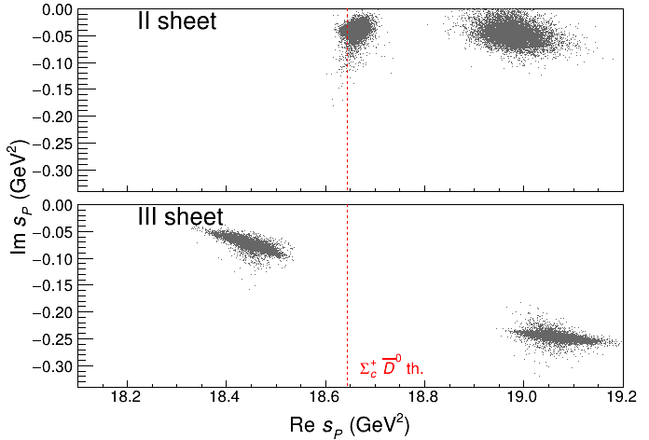
Minimal(istic) model for $P_{c}(4312)$
Effective range expansion We can set $c_{ii}=0$ to reduce to the scattering length approximation
Points to a virtual state
Doesn’t point to a resonance
$$c_{ii}=0$$
Finite $c_{ii}$
A. Pilloni – Theoretical review of exotic states
Notes:
2 slides su Zc, a Bes e a Belle
2 slide su tetraquark model: dall’hamiltoniana di Jaffe al calcolo delle masse
1 slide su molecular models, dove sono i carichi? (non in Tornqvist, si in Hanhart, vedere Braaten, citare Nefediev)
2 slides su decay channels, dove si dovrebbe vedere, e a seconda del modello, vedere qualche plot
1 slide su Y(4260), tetraquark? C’è lo strano (si vede la f0)
1 slide su Zc a cleo (anche il neutro)

Slide 28
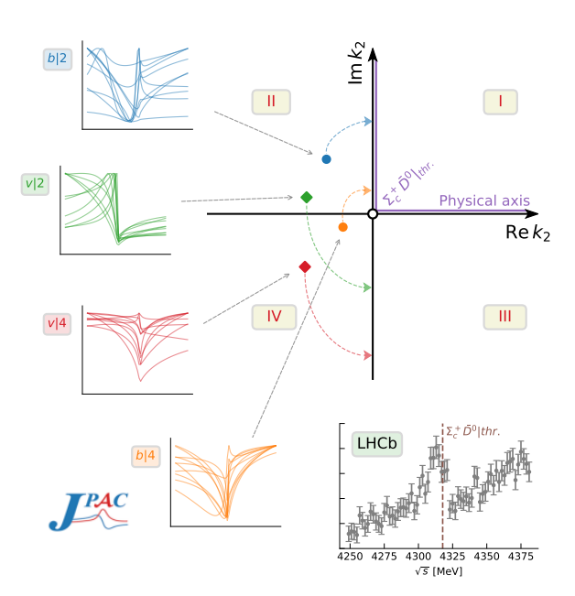
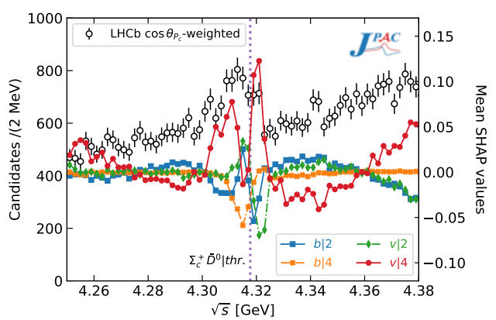
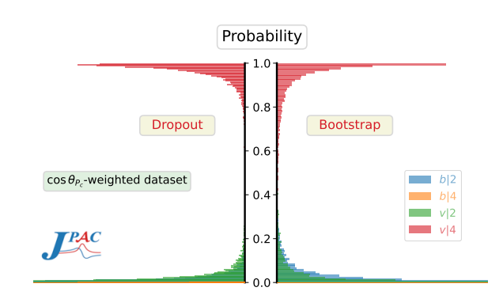
Minimal(istic) model with ANN
Ng, et al. (JPAC), PRD 105, L091501
Same conclusion reached if the analysis is performed with a Deep Neural Network
The peak region has the largest impact for the decision
Highest probability for a virtual state in the IV sheet
A. Pilloni – Theoretical review of exotic states
Notes:
2 slides su Zc, a Bes e a Belle
2 slide su tetraquark model: dall’hamiltoniana di Jaffe al calcolo delle masse
1 slide su molecular models, dove sono i carichi? (non in Tornqvist, si in Hanhart, vedere Braaten, citare Nefediev)
2 slides su decay channels, dove si dovrebbe vedere, e a seconda del modello, vedere qualche plot
1 slide su Y(4260), tetraquark? C’è lo strano (si vede la f0)
1 slide su Zc a cleo (anche il neutro)

Slide 29
Conclusions & prospects
The study of heavy-heavy quark sector is a challenging task
Experiments are very prolific! Constant feedback on predictions
Study of spectra and decay patterns will improve our understanding, new data expected by, BESIII, LHCb, Belle II
Complementary models are useful to describe the XYZ sector
A more refined study of amplitudes provides a complimentary tool to give insights on the nature of some of the states
Thank you
A. Pilloni – Theoretical review of exotic states
Notes:
2 slides su Zc, a Bes e a Belle
2 slide su tetraquark model: dall’hamiltoniana di Jaffe al calcolo delle masse
1 slide su molecular models, dove sono i carichi? (non in Tornqvist, si in Hanhart, vedere Braaten, citare Nefediev)
2 slides su decay channels, dove si dovrebbe vedere, e a seconda del modello, vedere qualche plot
1 slide su Y(4260), tetraquark? C’è lo strano (si vede la f0)
1 slide su Zc a cleo (anche il neutro)

Slide 30
Backup

Slide 31
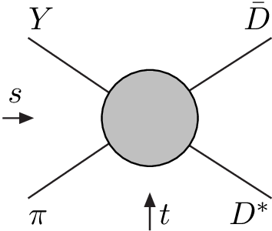
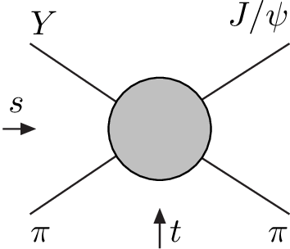
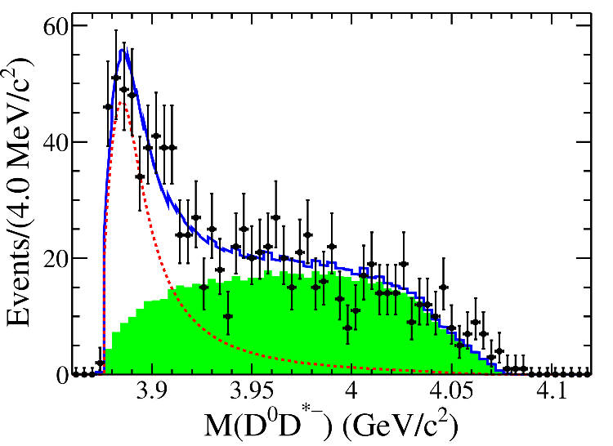
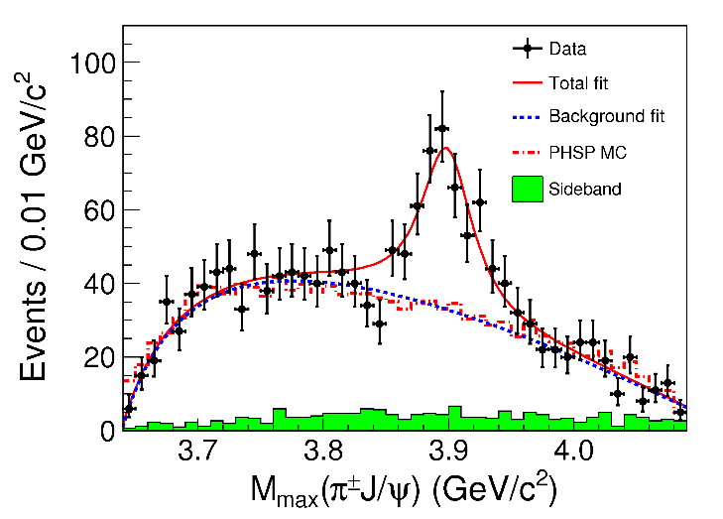
Amplitude analysis for $Z_{c}(3900)$
One can test different parametrizations of the amplitude, different singularities → different natures
AP et al. (JPAC), PLB772, 200
A. Pilloni – Theoretical review of exotic states
Notes:
Controlla la parte su Regge

Slide 32
Amplitude model
$$Z_{c}\left(3900\right)?$$
$${u: D}_{0}(2400)$$
$${u:Z}_{c}\left(3900\right)?$$
$$"σ, f_{0}(980)"$$
$$D_{1}(2420)$$
Logarithmic branch points simulate resonant behavior, only in special kinematics
Coleman and Norton, Nuovo Cim. 38, 438
Schmid, Phys.Rev. 154, 1363
Szczepaniak, PLB747, 410-416
Szczepaniak, PLB757, 61-64
Guo, Nucl.Phys.Rev.37, 406
$$π$$
Isobars
Rescattering
$$D_{1}$$
$$Y(4260)$$
$$D^{∗}$$
$$π$$
$$\overline{D}$$
$$J/ψ$$
Triangle singularity?
A. Pilloni – Theoretical review of exotic states

Slide 33
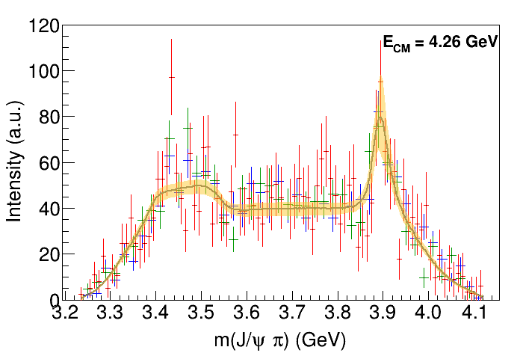
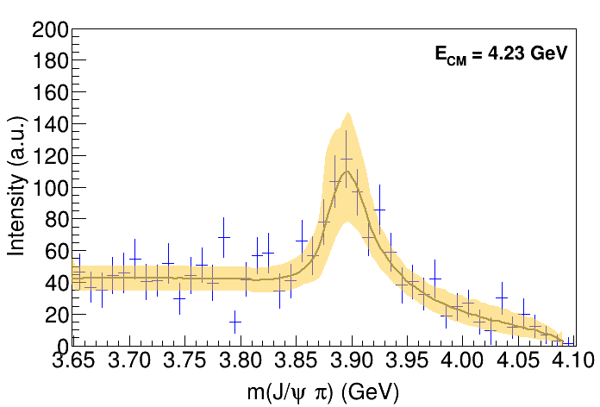
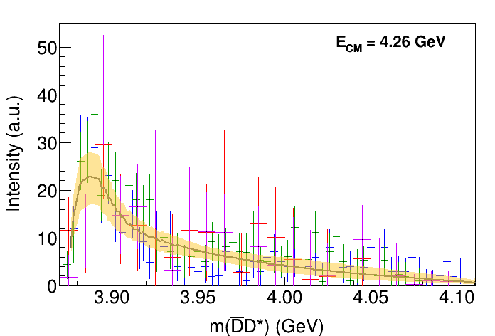
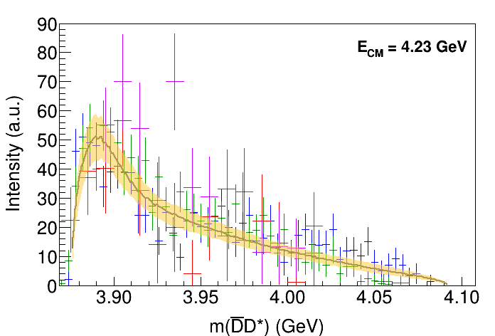
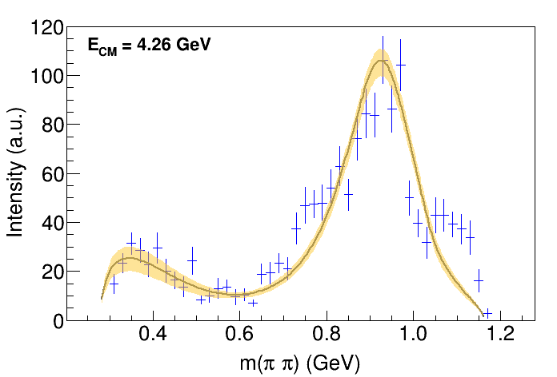
Fit: III
( data)
A. Pilloni – Theoretical review of exotic states
Notes:
Controlla la parte su Regge

Slide 34
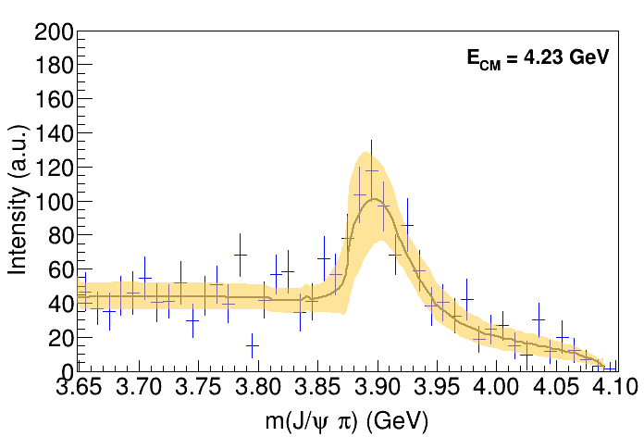
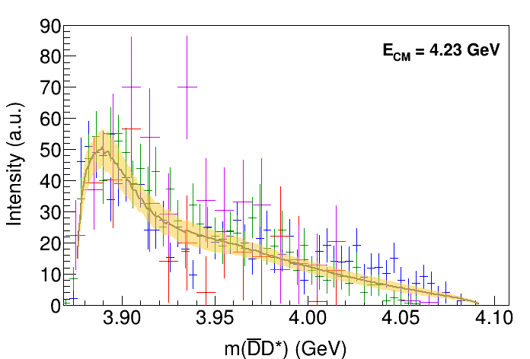
Fit: III+tr.
( data)
A. Pilloni – Theoretical review of exotic states
Notes:
Controlla la parte su Regge

Slide 35
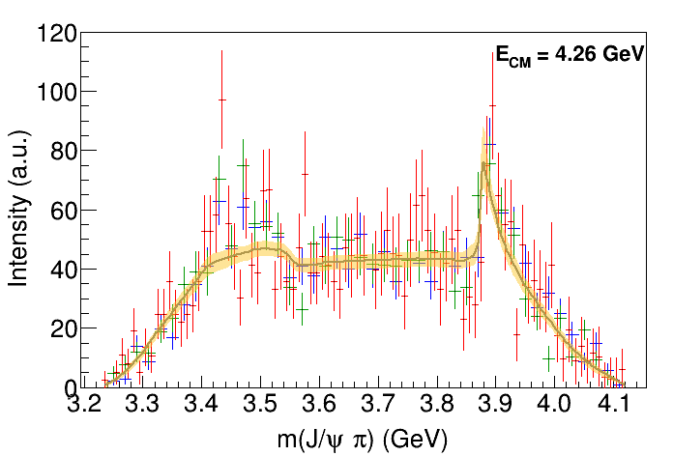
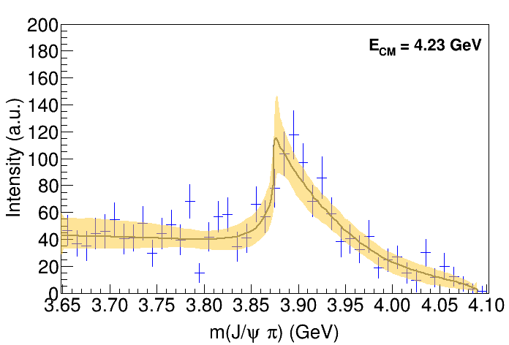
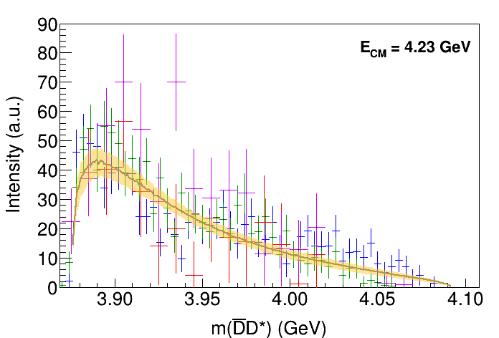
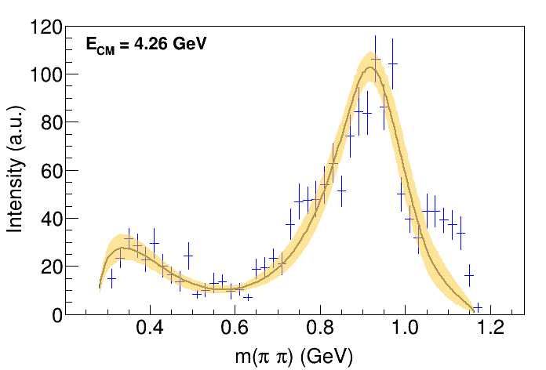
Fit: IV+tr.
( data)
A. Pilloni – Theoretical review of exotic states
Notes:
Controlla la parte su Regge

Slide 36
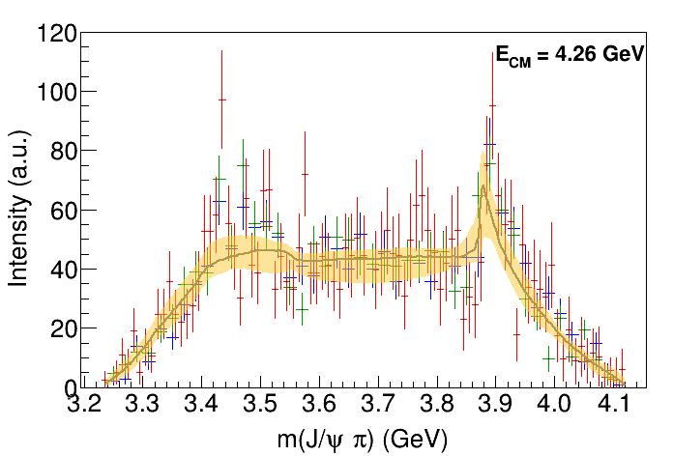
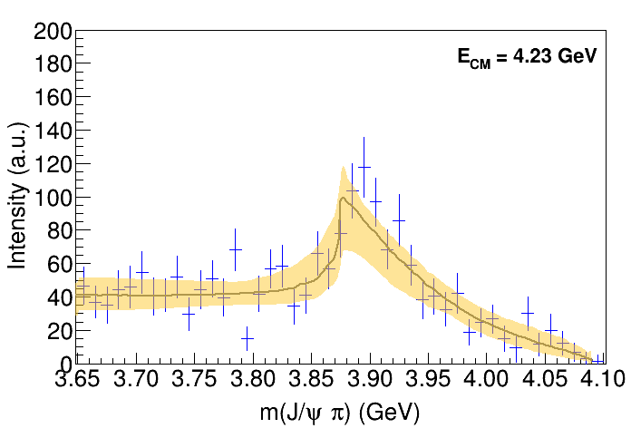
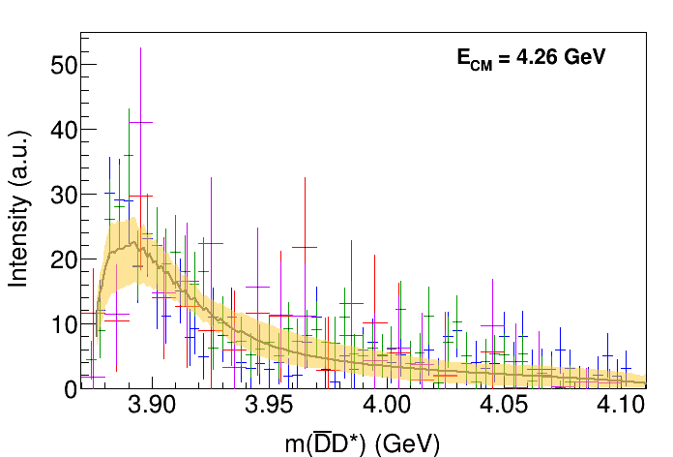
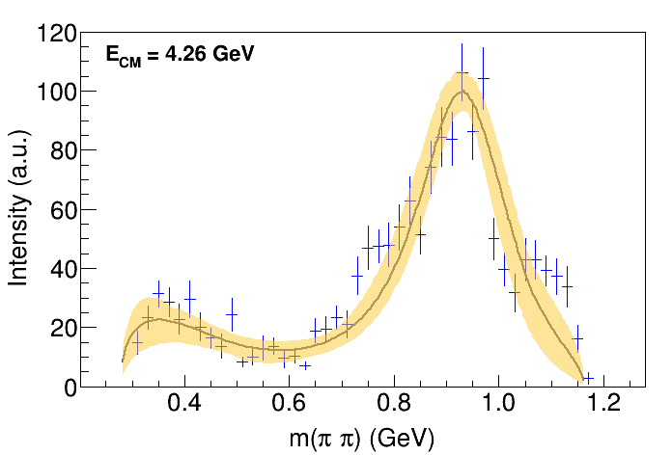
Fit: tr.
( data)
A. Pilloni – Theoretical review of exotic states
Notes:
Controlla la parte su Regge

Slide 37
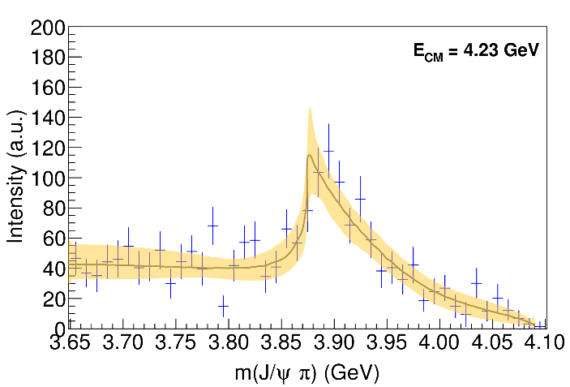
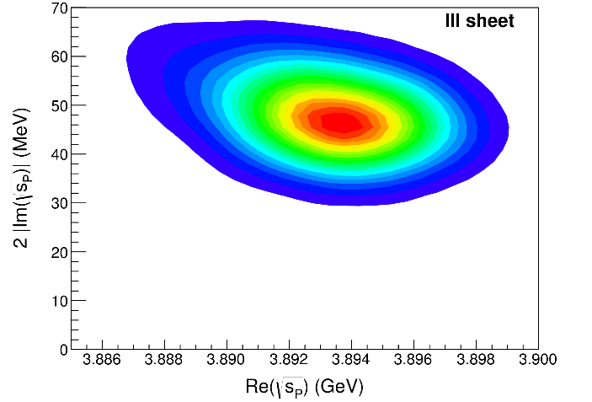
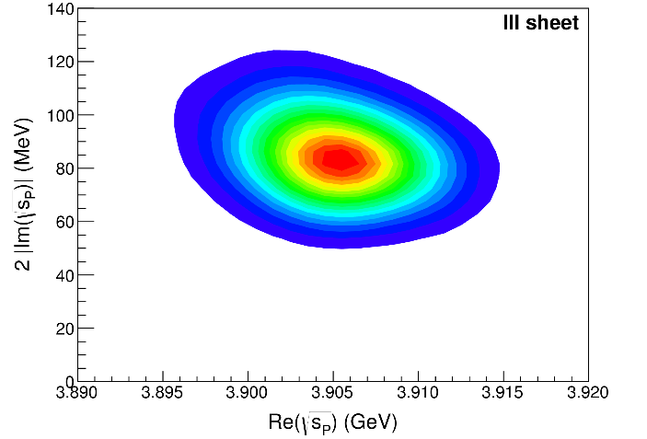
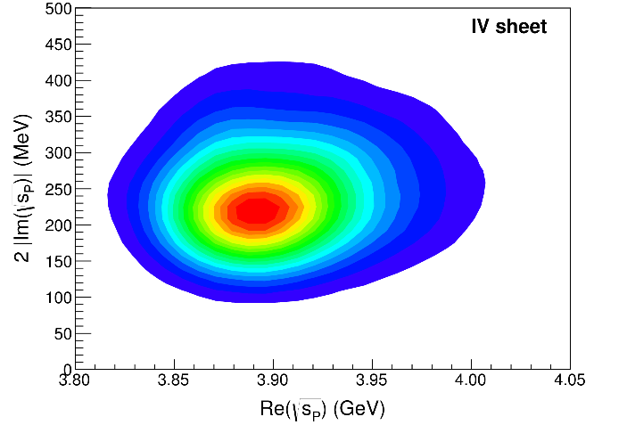
Pole extraction
III
III+tr.
IV+tr.
A. Pilloni – Theoretical review of exotic states
Not conclusive at this stage
Notes:
Controlla la parte su Regge

Slide 38
Multiscale system
Systematically integrate out the heavy scale,
$$m_{Q}≫Λ_{QCD}$$
$$m_{Q}≫m_{Q}v≫m_{Q}v^{2}$$
$$m_{b}∼5 \text{GeV}, m_{c}∼1.5 \text{GeV}$$
$$v_{b}^{2}∼0.1, v_{c}^{2}∼0.3$$
Full QCD
NRQCD
pNRQCD
Factorization (to be proved) of universal LDMEs
Good description of many production channels, some known puzzles (polarizations)
A. Pilloni – Theoretical review of exotic states
Notes:
2 slides su Zc, a Bes e a Belle
2 slide su tetraquark model: dall’hamiltoniana di Jaffe al calcolo delle masse
1 slide su molecular models, dove sono i carichi? (non in Tornqvist, si in Hanhart, vedere Braaten, citare Nefediev)
2 slides su decay channels, dove si dovrebbe vedere, e a seconda del modello, vedere qualche plot
1 slide su Y(4260), tetraquark? C’è lo strano (si vede la f0)
1 slide su Zc a cleo (anche il neutro)

Slide 39
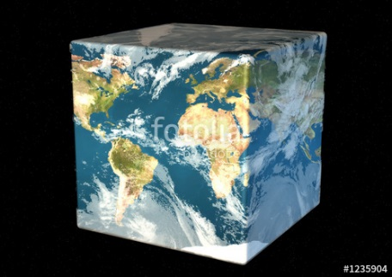
Hadron Spectroscopy
Hybrids
Tetraquark
Meson
Baryon
Glueball
$$π$$
$$π$$
$$J/ψ$$
$$π$$
Hadroquarkonium
Molecule
Experiment
Data
Amplitude analysis
Properties,
Model building
Lattice QCD
Interpretations on the spectrum leads to understanding fundamental laws of nature

Slide 40
Very open charm: the $T_{cc}^{+}$
A supernarrow state is seen at the $D^{∗+}D^{0}$ threshold
BW parameters give
$δm_{BW}=−273±61 \text{keV}$
$Γ_{BW}=410±65 \text{keV}$
It cannot mix with ordinary charmonia It does not have lighter open channels
A. Pilloni – Theoretical review of exotic states
Notes:
Y(4260), M=4263 +- 5, Gamma = 95+-14
D_1(2420)^0, M=2421.3 ±0.6, Gamma =27.1 ±2.7
D_1(2420)^+-, M=2423.4 ±3.1, Gamma =25 ±6
I D_1 hanno J^P = 1^+
La molecola D_1 D sta 22 MeV sotto
Se la Y è D_1 D, il pione lega fortemente, come fa la Y a essere così larga?
Come funziona lo scambio del pione???

Slide 41
JPAC 2021
Jefferson Lab
Victor Mokeev
Miguel Albaladejo
Astrid Hiller Blin
Pedagogical U. Kraków
Lukasz Bibrzycki
INP Kraków
Robert Kaminski
Chiao-Tung University
Robert Perry
INFN Roma
Alessandro Pilloni
Indiana U.
Emilie Passemar
Adam Szczepaniak (also JLab)
Sergi Gonzàles-Solís
Nathan Sherrill
Daniel Winney
Sebastian Dawid
TUM
Misha Mikhasenko
W&M
Arkaitz Rodas
Barcelona U.
Vincent Mathieu
ODU
Andrew Jackura
UNAM
César Fernández-Ramírez
Jorge Silva-Castro
INFN Genova
Andrea Celentano
JGU-Mainz U.
Igor Danilkin
Faculty/Staff
Postdoc
Students
Members affiliated with CLAS, GlueX, LHCb, BESIII, BaBar, COMPASS
A. Pilloni – Theoretical review of exotic states

Slide 42
Joint Physics Analysis Center
Bottom-up approaches are important!
Joint effort between theorists and experimentalists in support of experimental data from JLab12 and other accelerator laboratories
Cooperation between JPAC and experiments: co-authoring papers
http://www.indiana.edu/~jpac
Thank you!
A. Pilloni – Theoretical review of exotic states

Slide 43
Bound and virtual states
The situation is more complicated when more channels are open
Virtual state
Bound state
Resonance
A. Pilloni – Theoretical review of exotic states
Notes:
Controlla la parte su Regge

Slide 44
Weinberg’s criterion and lineshapes
Let us imagine to have a theory with a bound state with a binding momentum much smaller than the inverse of the range of the potential
The potential is just a delta function, we calculate the $2→2$ scattering amplitude
+
+
+ …
$$A(E)=\frac{1}{1/a−i\sqrt{2μE}}$$
This has a pole at $E_{B}=−\frac{1}{2μa^{2}}$ and residue $g^{2}=\sqrt{\frac{2B}{μ}}$
A. Pilloni – Theoretical review of exotic states
Notes:
Controlla la parte su Regge

Slide 45
Weinberg’s criterion and lineshapes
Now let us consider the propagation of a bare intermediate state
+
+
+ …
$$A\left(E\right)=\frac{g_{0}^{2}}{E_{0}−E−ig_{0}^{2}\sqrt{2μE}}=\frac{g_{0}^{2}}{{−E}_{B}−E−ig_{0}^{2}\sqrt{2μE}−g_{0}^{2}\sqrt{2μE_{B}}}$$
This has a pole at $E_{B}$ and residue $g^{2}=\sqrt{\frac{2B}{μ}}\left(1−Z\right)$ where $Z$ is the w.f. renormalization, $Z={\left(1+g_{0}^{2}\sqrt{\frac{μ}{2B}}\right)}^{−1}$= overlap between the bare state and the continuum
A. Pilloni – Theoretical review of exotic states
Notes:
Controlla la parte su Regge

Slide 46
Weinberg’s criterion and lineshapes
The amplitude can be rewritten as
$$A\left(E\right)=\frac{1}{\frac{1}{a}+\frac{1}{2}r_{0}k^{2}−ik}$$
Thus identifying $a=−2 \frac{1−Z}{2−Z}\frac{1}{\sqrt{2μE_{B}}}$, $r_{0}=−\frac{Z}{1−Z}\frac{1}{\sqrt{2μE_{B}}}$
So a negative $r_{0}$ points to a short range component in the wave function
This is true up to corrections of the order of the range of the potential, which btw are positive under general assumptions
Esposito, Maiani, Pilloni, Polosa, Riquer, 105 (2022) 3, L031503
A. Pilloni – Theoretical review of exotic states
Notes:
Controlla la parte su Regge

Slide 47
L. Maiani
A. Pilloni – Theoretical review of exotic states
Notes:
Controlla la parte su Regge

Slide 48
L. Maiani
A. Pilloni – Theoretical review of exotic states
Notes:
Controlla la parte su Regge

Slide 49
Triangle singularity
$$π$$
$$D_{1}$$
Logarithmic branch points can simulate a resonant behavior, only in very special kinematical conditions
Coleman and Norton, Nuovo Cim. 38, 438
$$Y(4260)$$
$$D^{∗}$$
$$π$$
$$\overline{D}$$
$$J/ψ$$
However, this effects cancels in Dalitz projections, no peaks Schmid, Phys.Rev. 154, 1363
Szczepaniak, PLB747, 410-416
Szczepaniak, PLB757, 61-64
Guo, Meissner, Wang, Yang PRD92, 071502
...but the cancellation can be spread in different channels, you might still see peaks in other channels only!
A. Pilloni – Theoretical review of exotic states

Slide 50
Fit summary
III
IV+tr.
III+tr.
tr.
Naive loglikelihood ratio test give a $∼4σ$ significance of the scenario III+tr. over IV+tr., looking at plots it looks too much – better using some more solid test
A. Pilloni – Theoretical review of exotic states
Notes:
Controlla la parte su Regge

Slide 51
Testing scenarios
We approximate all the particles to be scalar – this affects the value of couplings, which are not normalized anyway – but not the position of singularities. This also limits the number of free parameters
The scattering matrix is parametrized as ${\left(t^{−1}\right)}_{ij}=K_{ij}−i ρ_{i} δ_{ij}$
Four different scenarios considered:
«III»: the K matrix is $\frac{g_{i} g_{j}}{M^{2}−s}$, this generates a pole in the closest unphysical sheet the rescattering integral is set to zero
«III+tr.»: same, but with the correct value of the rescattering integral
«IV+tr.»: the K matrix is constant, this generates a virtual state pole in the IV sheet
«tr.»: same, but the pole is pushed far away by adding a penalty in the $χ^{2}$
A. Pilloni – Theoretical review of exotic states

